Slide 1
Creational Pattern
Design Pattern

Slide 2
What is Creational Pattern
As it names suggest, it responsible for creating objects in a controlled manner.
Two dominant ideas
Encapsulation of concrete class that uses the system
Hiding how these concrete classes are created and been combined
So it's been categorized further:
Object Creational Pattern
Objects creation
Class Creational Pattern
Class instantiation
Notes:
Object creational pattern - defer part of its object creation to another object
Class creational pattern - defers to object creation of its subclasses

Slide 3
What are the Creational Pattern
Factory Method Pattern
Abstract Factory Pattern
Builder Pattern
Prototype Pattern
Singleton Pattern

Slide 4
Factory Method Pattern
One of the most used design pattern
Let class differ instantiation to subclasses
Is similar to Abstract Factory method without the emphasis on families
Factory method is a way of creating object as Template Method is to implements algorithm
Other design pattern requires new classes unlike Factory method, that only require a new operation
Notes:
Factory method is a way of creating objects without exposing the creation logic to the client and refer to newly created object using a common interface
No.4

Slide 5
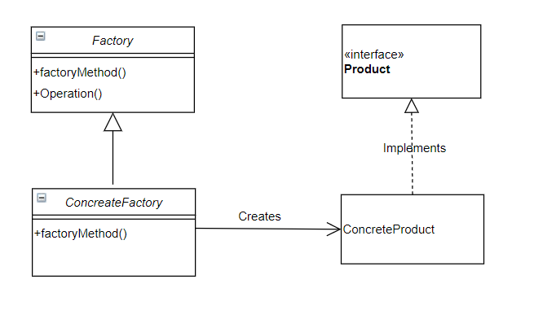
Factory Method Pattern - UML
Notes:
The concreteProduct class implements interface product that the ConcreteFactory class will create that will be extended through Factory class

Slide 6
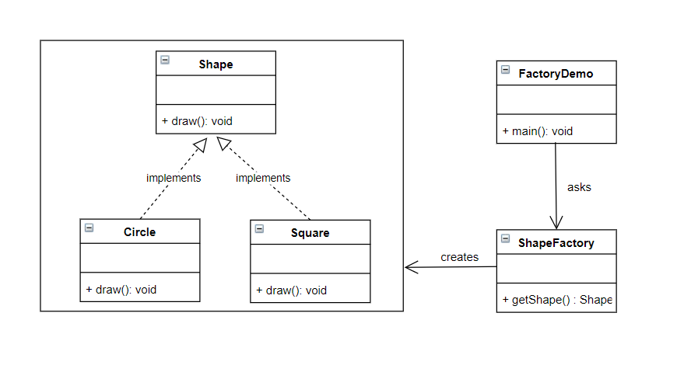
Example
Notes:
We have a ShapeFactory class which create two shape which are the two concrete classes (Circle and Square) which implements the interface Shape class.

Slide 7
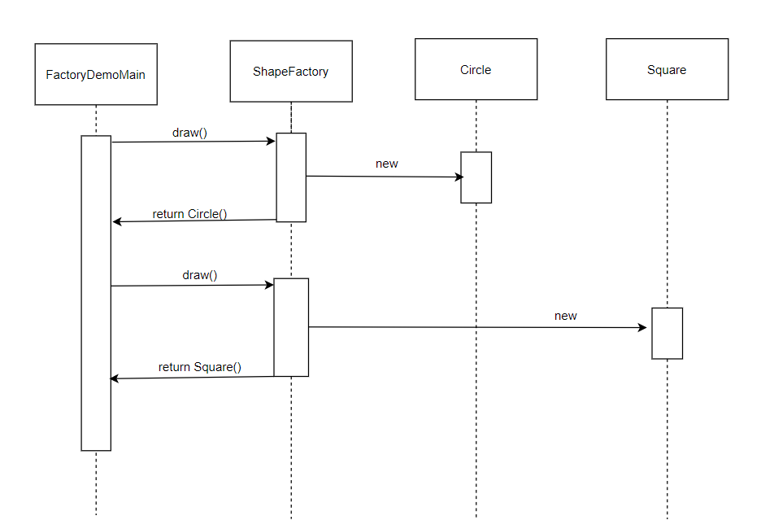
Factory Diagram Sequence
Notes:
The FactoryDemoMain requests ShapeFactory for the creation of circle
Then the ShapeFactory finds the concrete implementation of Circle and creates a new instance
Then the ShapeFactory will return the newly created Circle
Same as above

Slide 8
Interface and Concrete class
Circle.java
public class Circle implements Shape {
@Override
public void draw( ) {
System.out.println(“This is a circle”);
}
}
Shape.java
public interface Shape {
void draw( );
}
Square.java
public class Square implements Shape {
@Override
public void draw( ) {
System.out.println(“This is a square”);
}
}

Slide 9
Factory code - ShapeFactory
public class ShapeFactory {
//use getShape method to get object of type shape
public Shape getShape(String shapeType){
if(shapeType == null){
return null;
}
if(shapeType.equalsIgnoreCase("CIRCLE")){
return new Circle();
} else if(shapeType.equalsIgnoreCase("SQUARE")){
return new Square();
}
return null;
}
}

Slide 10
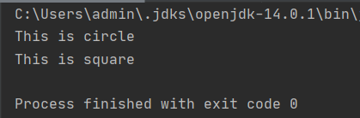
Factory code - FactoryDemoMain
public class FactoryDemoMain {
public static void main(String[] args) {
ShapeFactory shapeFactory = new ShapeFactory();
//get an object of Circle and call its draw method.
Shape shape1 = shapeFactory.getShape("CIRCLE");
//call draw method of Circle
shape1.draw();
//get an object of Square and call its draw method.
Shape shape2 = shapeFactory.getShape("SQUARE");
//call draw method of square
shape2.draw();
}
}
Output

Slide 11
Abstract Factory Pattern
Works as super-factory that creates other factories.
Also called as factory of factories
Provides interface in creating families of related or dependent objects without specifying their concrete classes.

Slide 12
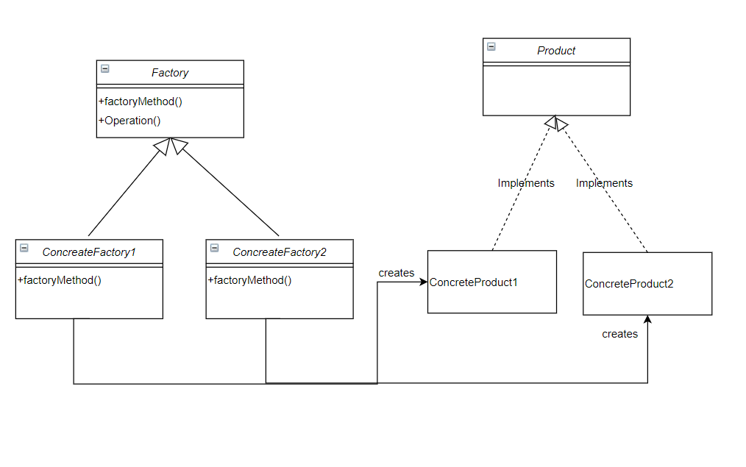
Abstract Factory Method - UML

Slide 13
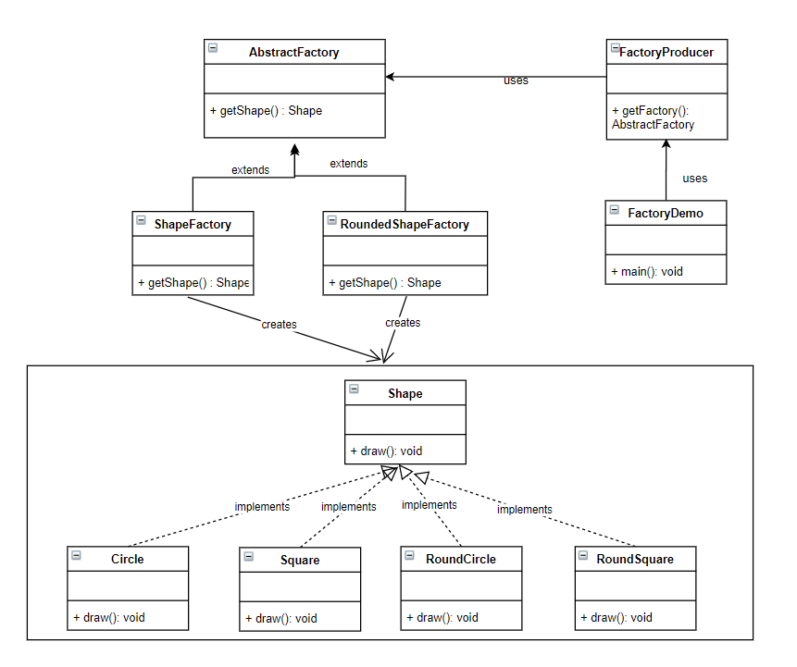
Abstract
Example

Slide 14
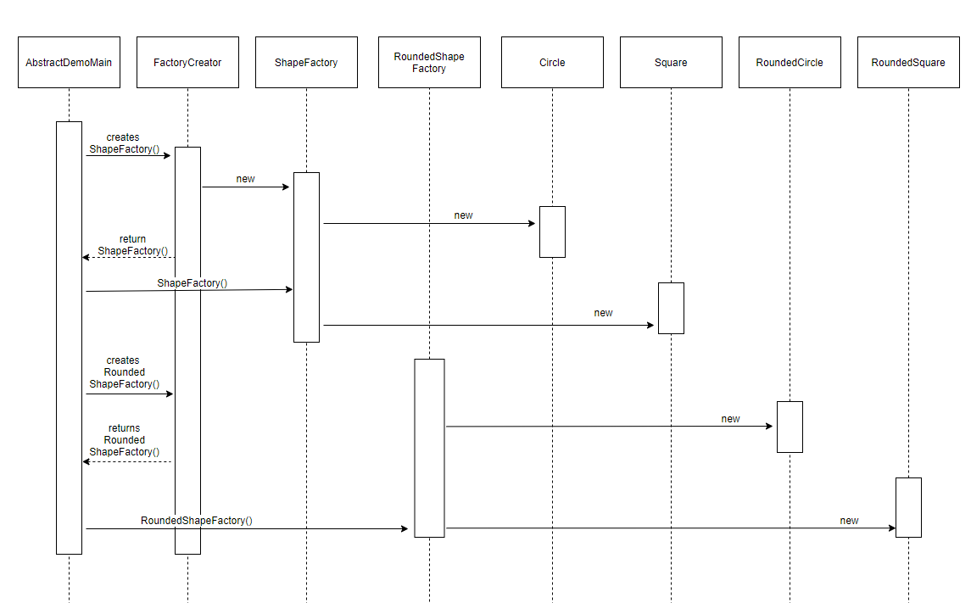
Abstract
Diagram
Sequence
Notes:
AbstractDemoMain will send a request to FactoryCreator to create a ShapeFactory
The the FactoryCreatory will create an instance of ShapeFactory and return it
Then the AbstractDemoMain will send a request to ShapeFactory to create the Circle and Square
Then the ShapeFactory will create an instance for both Circle and Square simultaneously which is a member of a family1, and returns it
Same with the RoundedShapeFactory (family2)

Slide 15
Abstract Code - Interface and Concrete class
Circle.java
public class Circle implements Shape {
@Override
public void draw( ) {
System.out.println(“This is a circle”);
}
}
RoundedCircle.java
public class RoundedCircle implements Shape {
@Override
public void draw( ) {
System.out.println(“This is a rounded circle”);
}
}
Shape.java
public interface Shape {
void draw( );
}
Square.java
public class Square implements Shape {
@Override
public void draw( ) {
System.out.println(“This is a square”);
}
}
RoundedSquare.java
public class RoundedSquare implements Shape {
@Override
public void draw( ) {
System.out.println(“This is a rounded square”);
}
}

Slide 16
Abstract code - Factory Concrete class
ShapeFactory.class
public class ShapeFactory extends AbstractFactory {
@Override
public Shape getShape(String shapeType){
if(shapeType.equalsIgnoreCase("RECTANGLE")){
return new Rectangle();
}else if(shapeType.equalsIgnoreCase("SQUARE")){
return new Square();
}
return null;
}
}
RoundedShapeFactory.class
public class RoundedShapeFactory extends AbstractFactory {
@Override
public Shape getShape(String shapeType){
if(shapeType.equalsIgnoreCase("RECTANGLE")){
return new RoundedRectangle();
}else if(shapeType.equalsIgnoreCase("SQUARE")){
return new RoundedSquare();
}
return null;
}
}

Slide 17
Abstract code - Abstract and FactoryProducer Class
AbstractFactory.class
public abstract class AbstractFactory {
public abstract Shape getShape(String shapeType) ;
}
FactoryProducer.class
public class FactoryProducer {
public static AbstractFactory getFactory(boolean rounded){
if(rounded){
return new RoundedShapeFactory();
}else{
return new ShapeFactory();
}
}
}

Slide 18
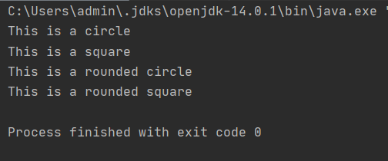
Abstract code
-
Factory
DemoMain
AbstractDemoMain.class
public abstract class AbstractDemoMain {
public static void main(String[] args) {
//get shape factory
AbstractFactory shapeFactory = FactoryProducer.getFactory(false);
//get an object of Shape Rectangle
Shape shape1 = shapeFactory.getShape("RECTANGLE");
//call draw method of Shape Rectangle
shape1.draw();
//get an object of Shape Square
Shape shape2 = shapeFactory.getShape("SQUARE");
//call draw method of Shape Square
shape2.draw();
//get shape factory
AbstractFactory shapeFactory1 = FactoryProducer.getFactory(true);
//get an object of Shape Rectangle
Shape shape3 = shapeFactory1.getShape("RECTANGLE");
//call draw method of Shape Rectangle
shape3.draw();
//get an object of Shape Square
Shape shape4 = shapeFactory1.getShape("SQUARE");
//call draw method of Shape Square
shape4.draw();
}
}
Output

Slide 19
Builder Pattern
Builds the final object step by step
Often builds a composite
Separates construction of complex object from its representation so that the same construction process can create different representations

Slide 20
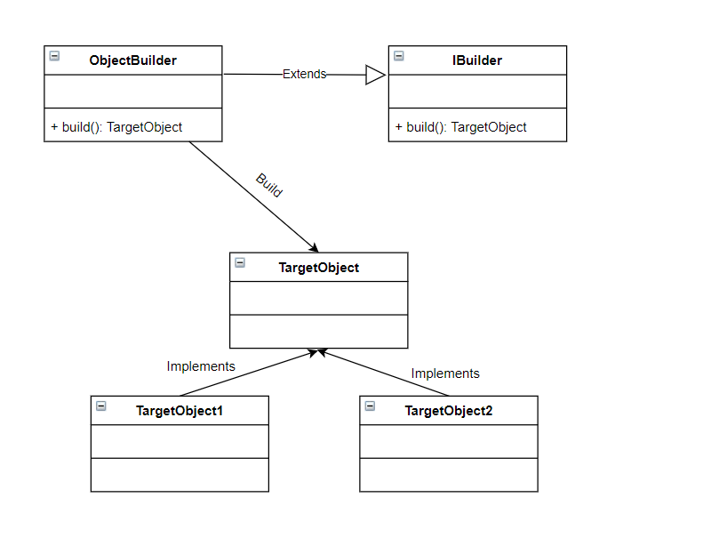
Builder
Pattern
-
UML

Slide 21
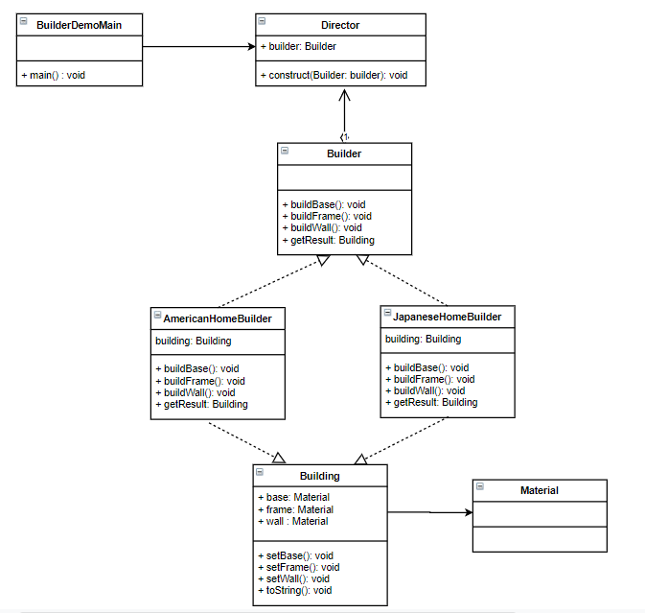
Builder Pattern Example

Slide 22
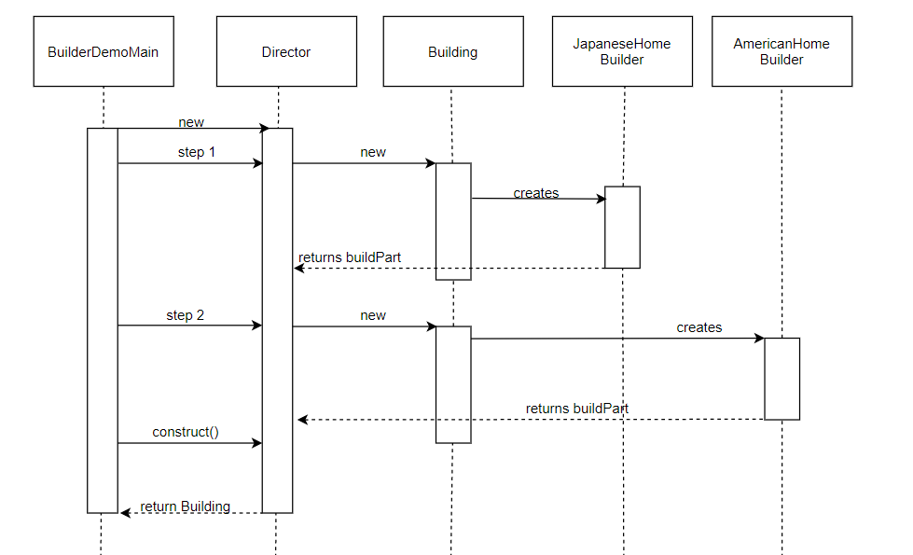
Builder
Diagram
Sequence
Notes:
BuilderDemoMain will create a new instance of Director
Then the BuilderDemoMain will execute step 1
Internally, it will create a new instance of Building
Then the JapanaseHomeBuilder will be created through Building and returns it
Then the BuilderDemoMain will execute step2
Internally, it will create a new instance of Building
Then the AmericanHomeBuilder will be created through Building and returns it
Finally the BuilderDemoMain will requests to the Director for the creationg of the Building, then take all the previously created objects and assignes them to Director and returns it

Slide 23
Builder Code -
Enum and Concrete class
Building.java
public class Building{
private Material base;
private Material frame;
private Material wall;
void setBase(Material m){
this.base = m;
}
void setFrame(Material m){
this.frame = m;
}
void setWall(Material m){
this.wall = m;
}
public String toString(){
return "[Base:" + this.base + ", Frame:" + this.frame + ", Wall:" + this.wall + "]";
}
}
Material.java
public enum Material{
WOOD,
CLAY,
CONCRETE,
SNOW
}

Slide 24
Builder code - Interface and Builder
Builder.class
public interface Builder{
void buildBase();
void buildFrame();
void buildWall();
Building getResult();
}
Director.class
public class Director{
private Builder builder;
Director(Builder builder){
this.builder = builder;
}
Building construct(){
this.builder.buildBase();
this.builder.buildFrame();
this.builder.buildWall();
return this.builder.getResult();
}
}

Slide 25
Builder Abstract code -Concrete class
Builder.class
public class AmericanHomeBuilder implements Builder{
private Building building;
AmericanHomeBuilder(){
this.building = new Building();
}
public void buildBase(){
this.building.setBase(Material.SNOW);
}
public void buildFrame(){
this.building.setFrame(Material.SNOW);
}
public void buildWall(){
this.building.setWall(Material.SNOW);
}
public Building getResult(){
return this.building;
}
}
Director.class
public class JapaneseHouseBuilder implements Builder{
private Building building;
JapaneseHouseBuilder(){
this.building = new Building();
}
public void buildBase(){
this.building.setBase(Material.CONCRETE);
}
public void buildFrame(){
this.building.setFrame(Material.WOOD);
}
public void buildWall(){
this.building.setWall(Material.CLAY);
}
public Building getResult(){
return this.building;
}
}

Slide 26
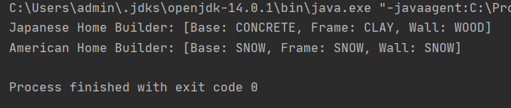
Abstract code - Main Class
BuilderDemoMain.class
public class BuilderDemoMain {
public static void main(String[] argv){
Director d1 = new Director(new JapaneseHouseBuilder());
Director d2 = new Director(new AmericanHomeBuilder());
Building b1 = d1.construct();
Building b2 = d2.construct();
System.out.println("Japanese Home Builder: " + b2);
System.out.println("American Home Builder: " + b2);
}
}
Output

Slide 27
Prototype Pattern
Object cloning
This is only used when creation of objects is costly
This pattern also helps to hide the strategy we used when cloning objects
Add a clone() method to the existing “product” hierarchy
Design a “registry” that maintains a cache of prototypical objects
Doesn’t require subclassing, but require an “initialize” operation
It does not require a class but more like an object when creating a new objects
Notes:
No.1 New objects are created from a pool of previously created and stored prototypes
No. 2 Prototype can avoid expensive "creation from scratch", and support cheap cloning of a pre-initialized prototype.
No.5 This registry could encapsulated a new Factory class or in the base class of the “product” hierarchy

Slide 28
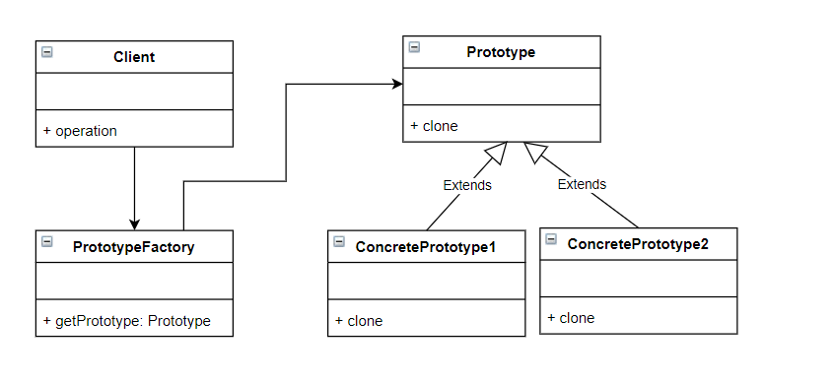
Prototype
Pattern
-
UML

Slide 29
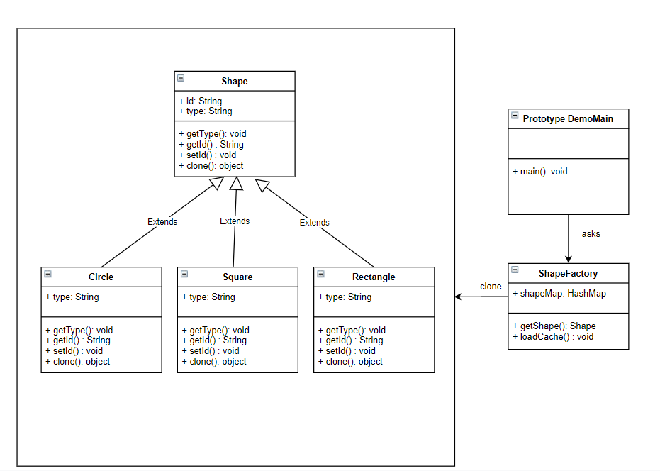
Prototype
Example

Slide 30
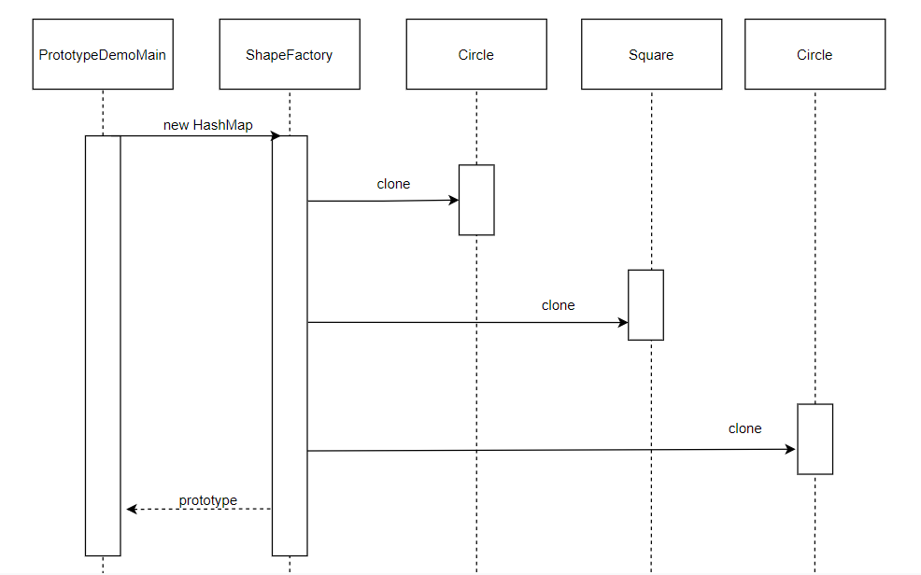
Prototype
Diagram
Sequence
Notes:
PrototypeDemoMain will creates a new HashMap instance of ShapeFactory
Then it will clone the Shape Circle and returns it
Then it will again clone the Shape Square and returns it
Then last clone will be the Shae Circle and returns it
Finally, the PrototypeDemoMain will get the previously created clones and assign them then returns it

Slide 31
Prototype
Code -
Abstract Class
Shape.java
public abstract class Shape implements Cloneable {
private String id;
protected String type;
abstract void draw();
public String getType(){
return type;
}
public String getId() {
return id;
}
public void setId(String id) {
this.id = id;
}
public Object clone() {
Object clone = null;
try {
clone = super.clone();
} catch (CloneNotSupportedException e) {
e.printStackTrace();
}
return clone;
}
}

Slide 32
Prototype
code
-
Concrete Class
Rectangle.class
public class Rectangle extends Shape {
public Rectangle(){
type = "Rectangle";
}
@Override
public void draw() {
System.out.println("Inside Rectangle::draw() method.");
}
}
Circle.class
public class Circle extends Shape {
public Circle(){
type = "Circle";
}
@Override
public void draw() {
System.out.println("Inside Circle::draw() method.");
}
}
Square.class
public class Square extends Shape {
public Square(){
type = "Square";
}
@Override
public void draw() {
System.out.println("Inside Square::draw() method.");
}
}

Slide 33
Builder
Code
-
Builder
Factory
Class
ShapeFactory.class
import java.util.Hashtable;
public class ShapeFactory {
private static Hashtable<String, Shape> shapeMap = new Hashtable<String, Shape>();
public static Shape getShape(String shapeId) {
Shape cachedShape = shapeMap.get(shapeId);
return (Shape) cachedShape.clone();
}
public static void loadCache() {
Circle circle = new Circle();
circle.setId("1");
shapeMap.put(circle.getId(),circle);
Square square = new Square();
square.setId("2");
shapeMap.put(square.getId(),square);
Rectangle rectangle = new Rectangle();
rectangle.setId("3");
shapeMap.put(rectangle.getId(), rectangle);
}
}

Slide 34
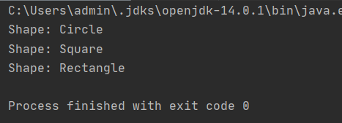
Abstract code - Main Class
PrototypeDemoMain.class
public class PrototypeDemoMain {
public static void main(String[] args) {
ShapeFactory.loadCache();
Shape clonedShape = (Shape) ShapeFactory.getShape("1");
System.out.println("Shape : " + clonedShape.getType());
Shape clonedShape2 = (Shape) ShapeFactory.getShape("2");
System.out.println("Shape : " + clonedShape2.getType());
Shape clonedShape3 = (Shape) ShapeFactory.getShape("3");
System.out.println("Shape : " + clonedShape3.getType());
}
}
Output

Slide 35
Singleton Pattern
Ensure that a class has only one instance and provide global access to it.
Simplest pattern.
Cannot be recommend to used due to code smell.
Encapsulated “initialization on first use”.
Define private static attribute in the “single instance” class
Define public static accessor function in the class
Define all constructors to be protected or private

Slide 36
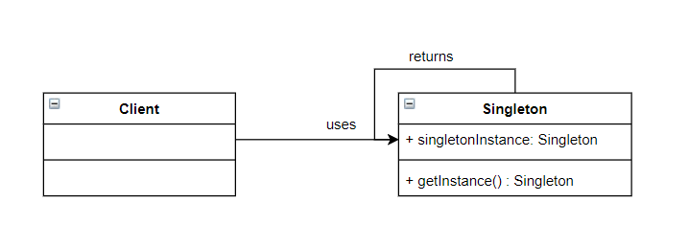
Singleton Pattern - UML

Slide 37
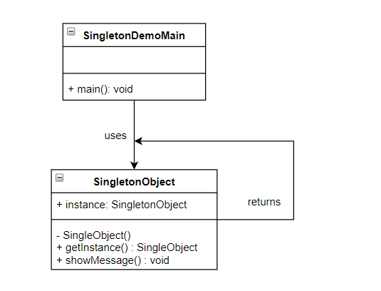
Singleton Example

Slide 38
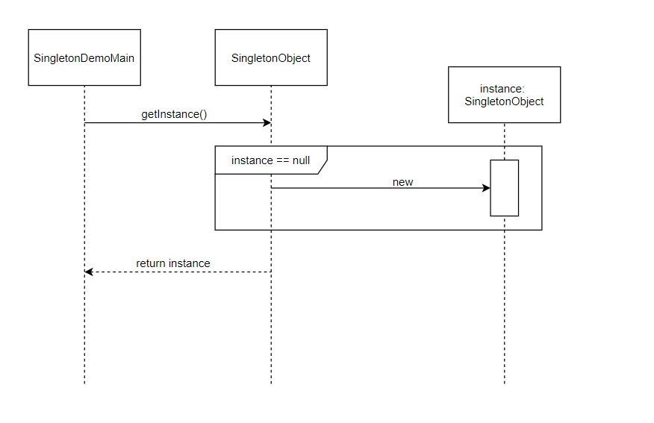
Singleton Diagram Sequence
Notes:
SingletonDemoMain will requests for an instance of the SingletonObject through getInstance method
Then the SingletonObject checks if the instance has already created, if not, it will create a new instance
Finally, either the newly created or existing instance will be returned

Slide 39
Singleton
Code
-
Concrete
Class
SingleObject.class
public class SingleObject {
//create an object of SingleObject
private static SingleObject instance = new SingleObject();
//make the constructor private so that this class cannot be
//instantiated
private SingleObject(){}
//Get the only object available
public static SingleObject getInstance(){
return instance;
}
public void showMessage(){
System.out.println("Hello World!");
}
}

Slide 40
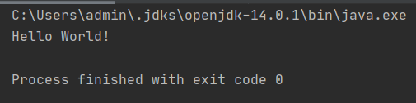
Prototype
code
-
Main
Class
SingletonDemoMain.class
public class SingletonDemoMain {
public static void main(String[] args) {
SingleObject object = SingleObject.getInstance();
//show the message
object.showMessage();
}
}
Output

